Slide 1
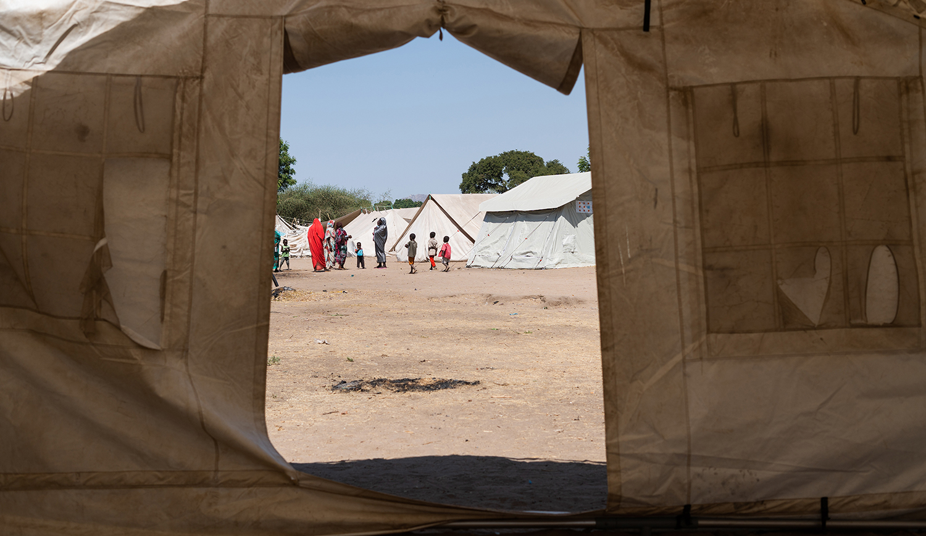

Location | Date | Time
Optimising
Armed Actor
Engagement for Protection
Outcomes
Facilitator’s Name

Slide 2
AGENDA
I.
II.
III.
How to achieve protection outcomes
Training objectives
Key concepts
IV.
IV.
V.
Shifting challenges into enablers
Evaluation and closing
Cover photo by: OCHA

Slide 3
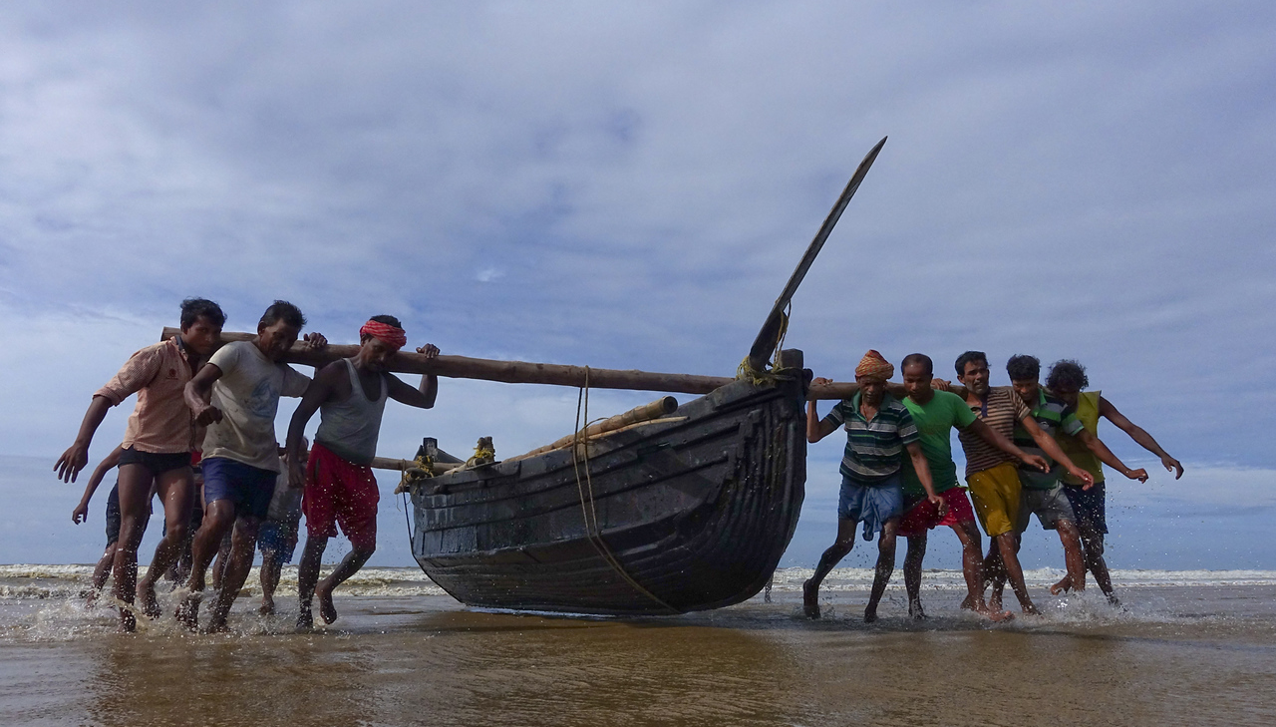
TRAINING OBJECTIVES
Photo by: Indranil Sengupta

Slide 4
AIMS OF THE MODULE
1
Improve the humanitarian community’s understanding of the role that humanitarian actors with responsibilities for engaging with armed actors can play in supporting risk reduction.
2
Increase the participation of humanitarian actors with responsibilities for engaging with armed actors in achieving protection outcomes.
This module is intended for humanitarian actors, specifically those with responsibilities for engaging with armed actors.

Slide 5
LEARNING OBJECTIVES
Participants gain a deeper understanding of protection risks and strategies to implement the Centrality of Protection and achieve protection outcomes.
Participants gain an understanding on how the skills, knowledge, and relationships of humanitarian actors with responsibilities for engaging with armed actors can contribute to achieving protection outcomes.
Participants gain insight into the key processes that contribute to the achievement of protection outcomes.
Participants can list at least three ways in which humanitarian actors with responsibilities for engaging with armed actors can support protection outcomes.
Participants can formulate a protection outcome relevant to humanitarian actors with responsibilities for engaging with armed actors.

Slide 6
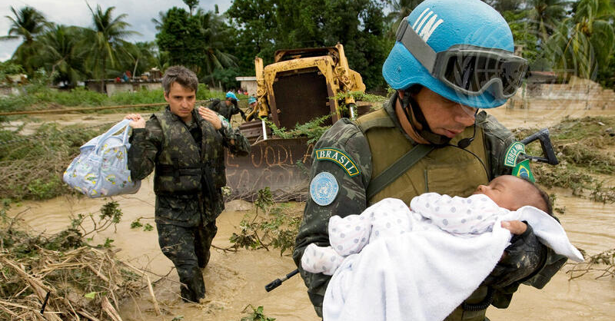
KEY CONCEPTS
Photo by: United Nations

Slide 7
WHAT IS ...
Humanitarian-armed actor engagement?
The “essential dialogue and interaction… [with]…military actors in humanitarian emergencies that is necessary to protect and promote humanitarian principles, avoid competition, minimize inconsistency and, where appropriate, pursue common goals.”
“Civil-military engagement is defined as the spectrum of possible interactions between humanitarian actors …and armed actors/military or militarised operations. This can range from coexistence to coordination and cooperation in some instances.”
— UN Civil-Military Coordination definition
— An NGO definition

Slide 8
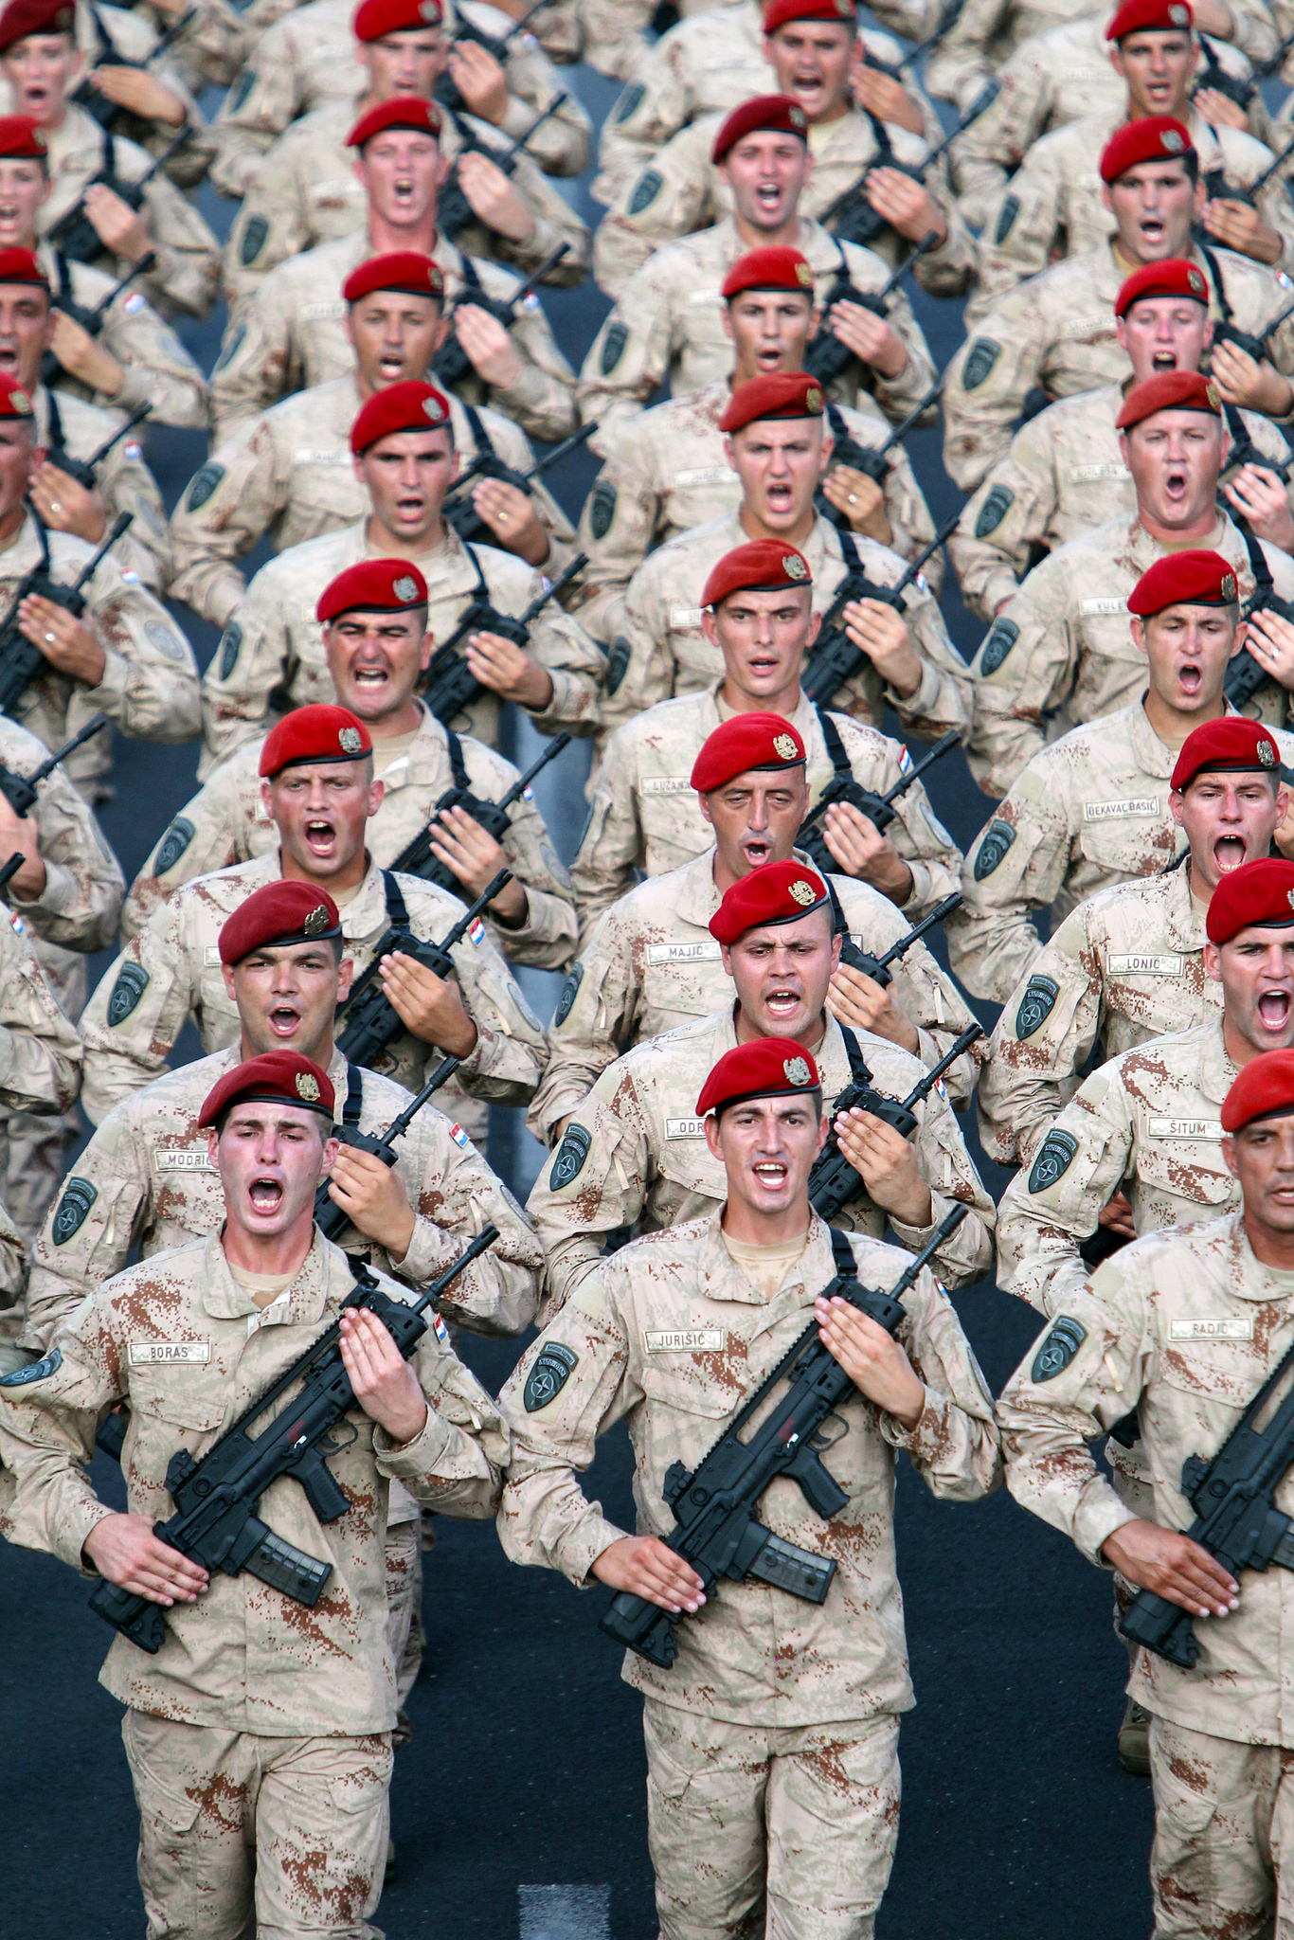
WHAT DO WE MEAN BY ...
Armed actors?
State-armed forces
Law enforcement entities
Non-State armed groups (NSAG)
Peacekeeping forces
Private Military and Security Contractors (PMSC)
Photo by: Goran Jakus

Slide 9
WHAT DO WE MEAN BY ...
Protection?
Protection is about people’s freedom from violence, coercion, and deliberate deprivation.
Protection work is “… all activities aimed at obtaining full respect for the rights of the individual in accordance with the letter and the spirit of the relevant bodies of law (i.e. International Human Rights Law (IHRL), International Humanitarian Law (IHL), International Refugee Law (IRL)).”
—IASC

Slide 10
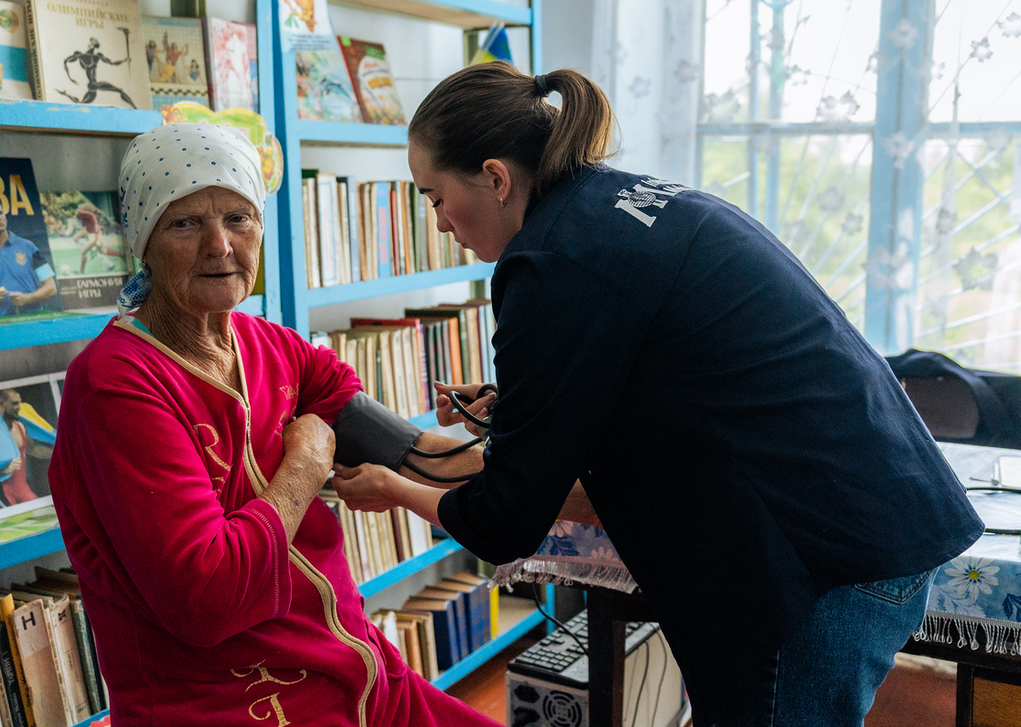
QUIZ
Photo by: Angel-Saxena
Test your knowledge of the Centrality of Protection
Photo by: Dmytro Mykhailov
Link to online quiz: https://forms.gle/1zS6HMvSNfzuswjv7

Slide 11
WHAT IS THE…
Centrality of Protection?
“Protection of all persons affected and at risk must inform humanitarian decision-making and response, including engagement with States and non-State parties to conflict. It must be central to our preparedness efforts, as part of immediate and life-saving activities, and throughout the duration of humanitarian response and beyond.”
—IASC
IASC requires all humanitarian actors to work together to understand and seek to prevent, mitigate, or end the risks of violence, coercion, and deliberate deprivation that people affected by conflict or disasters face.

Slide 12

UNDERLYING CoP PRINCIPLES
HC/HCTs are responsible for leading the collective strategic protection response.
Identifying and reducing protection risks must be understood first and foremost from the perspective of
crisis-affected people.
Wide-ranging partnerships
are essential
to mitigate multifaceted protection risks to affected people.
Regular and consistent engagement with duty bearers
is critical to reducing protection risks.
HCs: Humanitarian Coordinators; HCT: Humanitarian Country Team

Slide 13
WHAT IS A PROTECTION OUTCOME?
  Reduction or removal of risks from violence, coercion, or deliberate deprivation that affected people are facing by changing the behaviour, attitudes, policies, and practices of relevant stakeholders.
The reduction of risk = PROTECTION OUTCOME.

Slide 14
WHAT ARE …
Protection risks
VIOLENCE is the direct risks people face such as killing, torture, maiming, beatings, rape,
sexual assault, bombings, raids, and military strikes targeting civilians and their property.
COERCION is the threat of violence along the chain of events, including exploitation, restricted freedom of movement, forced displacement and prevented return, human trafficking, forced participation in conflict (i.e., child soldiers), slavery, and forced marriage.
DELIBERATE DEPRIVATION is the destruction or denial of things people need to survive such as military blockages, destruction of markets, denying access to humanitarian aid, destruction of/deliberate denial of access to critical infrastructure, property, assets, and means of livelihood, etc. as a tactic to restrict or deny people these services and necessities.

Slide 15
15 PROTECTION RISKS THAT GPC TRACKS:
Abduction, kidnapping, enforced disappearance, arbitrary or unlawful arrest, and/or detention
Attacks on civilians and other unlawful killings and attacks on civilian objects
Child and forced family separation
Early or forced marriage in children
Discrimination and stigmatization, denial of resources, opportunities, services, and/or humanitarian access
Disinformation and denial of access to information
Forced recruitment and association of children in armed forces and groups
Gender-based violence
Impediments and/or restrictions in access to legal identity, remedies, and justice
Presence of mines and other explosive ordnance
Psychological/emotional abuse or inflicted distress
Theft, extortion, forced eviction or destruction of personal property
Torture or cruel, inhumane, degrading treatment or punishment
Trafficking in persons, forced labour or slavery-like practices
Unlawful impediments or restrictions to freedom of movement, siege and forced displacement

Slide 16
THE PROTECTION RISK EQUATION
RISK can be understood as the combination of a THREAT, VULNERABILITY to that threat, and the relative CAPACITY of a person or group to resist or rebound from the effects of that threat.
This is often referred to as the PROTECTION RISK EQUATION.
=
x
Vulnerability
Risk
Threat
Capacity

Slide 17
PROTECTION OF CIVILIANS (PoC)
THE PROTECTION OF CIVILIANS comprises the efforts of armed actors themselves to prevent or mitigate the threats of violence, coercion and deliberate deprivation experienced by civilians – as such, it can be understood as contributing to the reduction of the “threat” and increase in “capacity” components of the risk equation.
International Humanitarian Law (IHL)
Armed actors
To understand their OBLIGATIONS
in this regard.
often turn to
Also known as Law of Armed Conflict (LOAC)
Existing PoC policies can be an entry point for engagement on protection outcomes.

Slide 18
…activities undertaken to improve the security of the population and people at risk and to ensure the full respect for the rights of groups and the individual recognised under regional instruments, including the African Charter of Human and Peoples’ Rights, the AU Convention for the Protection and Assistance of Internally Displaced Persons, and the Convention Governing the Specific Aspects of Refugee Problems in Africa, and international law, including humanitarian, human rights and refugee law.
—African Union definition

Slide 19
…all efforts taken to avoid, minimise and mitigate the negative effects that might arise from NATO and NATO-led military operations on the civilian population
and, when applicable, to protect civilians
from conflict-related physical violence
or threats of violence by other actors, including through the establishment
of a safe and secure environment.
—NATO definition

Slide 20
…without prejudice to the primary responsibility of the host state, integrated and coordinated activities by all civilian and uniformed mission components to prevent, deter or respond to threats of violence against civilians within the mission’s capabilities and areas of deployment through the use of all necessary means, up to and including deadly force.
—UN Peace Operations definition

Slide 21
CIVILIAN HARM MITIGATION AND RESPONSE
U.S. Department of Defense definition of civilian harm:
Civilian casualties and damage to or destruction of civilian objects (which do not constitute military objectives under the law of war) resulting from military operations. As a matter of DoD policy, other adverse effects on the civilian population and the personnel, organizations, resources, infrastructure, essential services, and systems on which civilian life depends resulting from military operations are also considered in CHMR efforts to the extent practicable…

Slide 22
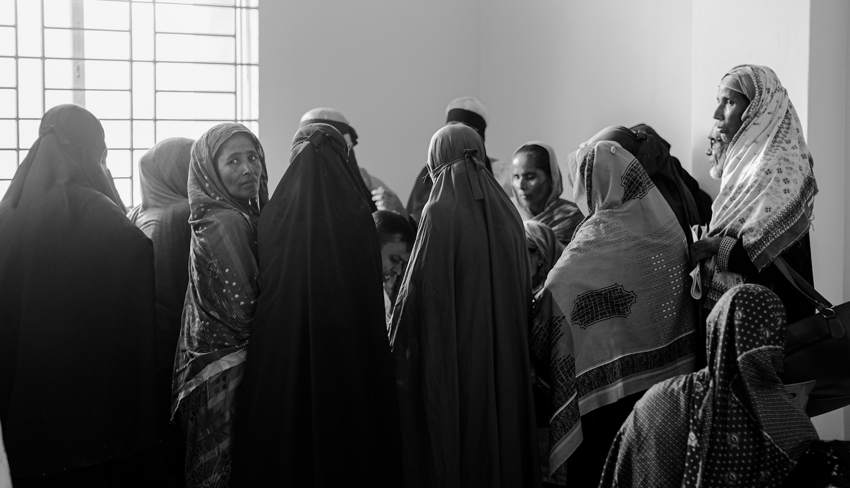
HOW TO ACHIEVE PROTECTION OUTCOMES
Photo by: Rana Muhammad Sohel

Slide 23
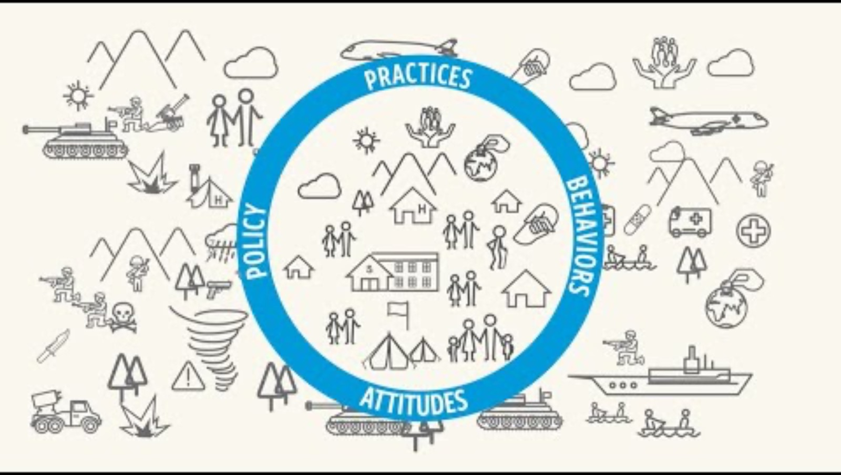

Slide 24
PROTECTION RISK ANALYSIS
CAR
RISK
THREAT
VULNERABILITY
CAPACITY
Bambari
Restricted freedom of movement of people and goods.
UPC and the Anti-Balakas in Bambari split the city into Muslim and Christian enclaves separated by a bridge and restrict the freedom of movement of goods and people among other forms of violence.
UPC imposed illicit taxes.
Traditional leaders were threatened by both NSAGs.
Christian community members on the right side of the bridge did not have access to the market.
Traders were taxed when trying to cross the bridge to the market.
Young people were able to communicate with each other across the divide.
UPC listened to imams, with whom they shared a common religion.
INTERVENTIONS
Young people engaged with the UPC on the freedom of movement, supported by imams, Christian women, and MINUSCA.

Slide 25
STRATEGY DEVELOPMENT/ACTION PLANNING
Mosul
RISK
THREAT
VULNERABILITY
CAPACITY
Iraq
Communities in Mosul experience civilian casualties from the use of EWIPA by ISF during the battle to reoccupy the city from ISIS.
The ISF decide to use EWIPA as a tactic to take back Mosul from ISIS forces; there is an absence of legal prohibitions on the use of specific weapons in urban areas.
Civilians unable to move due to mobility, age, or deliberate seizure of homes by ISIS forces, were trapped without escape.
Civilian networks in Mosul identified safe evacuation routes not being used by ISF or ISIS; civilians not under ISIS ‘house occupation’ could flee.
RISK REDUCTION INTERVENTIONS
CMCoord dialogue with ISF to put in place a civilian evacuation plan before Mosul invasion.
Advocacy with ISF to limit/cease the use of explosive weapons in urban areas led by humanitarian leadership and CMCoord officers.
Coordinated engagement with ISF and CMCoord to ensure specific routes are not damaged, including specific bridges to allow populations to escape.

Slide 26

IMPLEMENTATION AND MONITORING
Requires regular and consistent engagement with duty bearers.
Monitoring indicators should be in the action plan.
Outcome monitoring
is not conducted by M&E staff.
Document any reduction in a protection risk.
Documentation of interim results and reviews should take place regularly (e.g., at least twice yearly).
Necessary adaptations should be made to the action plan regularly.

Slide 27

CASE STUDY: Under the military rule of the LRA in Northern Uganda, the armed group brutally kidnapped both boys and girls to serve as soldiers to rebirth a new generation of Acholi people.
VULNERABILITY
To reduce the vulnerability, boys and girls commuted to town at night to reduce kidnapping.
Uganda
VULNERABILITY
To reduce the vulnerability, humanitarian organizations established night centres for children commuting into town to avoid exploitation and abuse.
Children at risk of being abducted by LRA
RISK
THREAT
In 2005, the UN Security Council adopted resolution 1612, a Monitoring and Reporting Mechanism (MRM) to monitor grave violations committed against children in times of armed conflict, and this was implemented in Northern Uganda to monitor the attacks by the LRA.
CAPACITY
Families with economic means sent their children to Kampala to avoid war.
Original vision
THREAT
Religious leaders negotiated with LRA soldiers for the release of children under 16 years old.
The children are safer. The combined effort to reduce the threat, vulnerability and increase capacity has led to a reduced risk of being kidnapped and killed by the LRA.
TIME

Slide 28
ADDED VALUE OF HUMANITARIAN ACTORS WITH RESPONSIBILITIES FOR ENGAGING ARMED ACTORS IN ACHIEVING PROTECTION OUTCOMES
Expertise, skills, knowledge gained through engaging/
negotiating with armed actors.
Understanding of the motivation, structures, hierarchies,
and de facto power dynamics within the armed actors, and therefore can be instrumental in mitigating real or perceived risks associated with engaging armed actors for risk reduction.
Existing dialogue
with armed actors (perpetrators and influencers).
Already exchange information with armed actors.
An established level of trust and mutual understanding with key decision makers within military/armed group structures that can be utilized for advocacy purposes.
Ability to actively monitor and adjust in coordination with other actors to achieve protection outcomes.

Slide 29
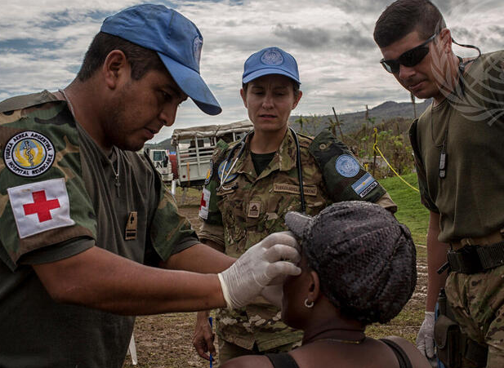
SURVEY
What’s your current contribution in the process for achieving protection outcomes?
Photo by: United Nations
Link to survey: https://forms.gle/LpcEx3DfwA4FME3WA

Slide 30
RESPONSIBILITIES AND COORDINATION
LEVEL
COORDINATION STRUCTURES
HEADED BY
COMPOSED OF
FOCUS
Humanitarian Country Team
HC/RC
Country directors of operationally relevant UN and non-UN organisations
Strategic coordination, decision-making and oversight
STRATEGIC
Inter-Cluster Coordination Group
OCHA
(Head of deputy)
Each cluster’s coordinator and essential thematic advisors
Operational collaboration to close gaps, eliminate duplication and ensure action is taken across clusters
OPERATIONAL
TECHNICAL
Food security and livelihood
Protection
Cluster Lead Agency
UN and non-UN partners
Technical coordination of 15 areas of activity
CCCM
ETC
Health
Logistics
Nutrition
Shelter/NFI
Education
WASH
Mine Action
GBV
Housing, Land, Property
Child Protection
Provides analytical and advisory support to ensure increased and sustained access. If tasked by the HCT, the group may conduct humanitarian negotiations on behalf of the humanitarian community.
TECHNICAL WORKING GROUPS
Including access and UN-CMCoord coordination platforms are auxiliary coordination forums whose place in the country coordination architecture is
context-adapted.
GBV
OCHA
& NGO
Access Working Group
Humanitarian organisations
Humanitarian organisations and military/ security representation. In some contexts, only humanitarian organisations meet in the forum and OCHA is the intermediary with armed actors.
Information-sharing, operational coordination, further advocate for humanitarian access and protection
UN-CMCoord Platform
OCHA

Slide 31
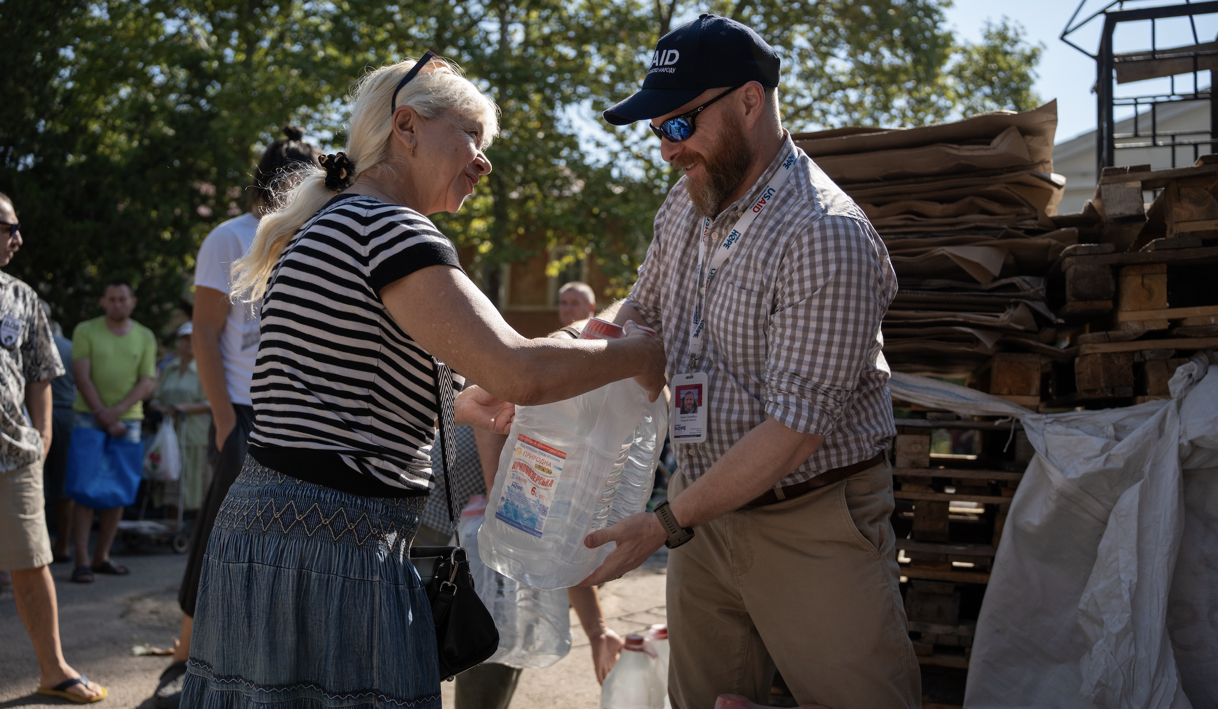
SHIFTING CHALLENGES INTO ENABLERS
Photo by: Nikita Hlazyrin

Slide 32
CHALLENGES
ENABLERS
Leadership takes responsibility; policies and guidance in place for armed actor engagement.
Undertaking proper stakeholder mapping and analysis as well as a conflict sensitivity analysis.
Reluctance to engage with armed actors on protection
Fear of legal ramifications
of engaging with NSAGs
Regular staff trainings and briefings.
Lack of sustained engagement with armed actors
Proper handovers of relationships.
Expertise leveraged insufficiently
Learn and build on what works in the field and match expertise.
Lack of diverse and collective approach
Develop common protection approaches.
Perception of not being seen as neutral
Consistent and regular engagement with armed actors.
Emphasise humanitarian principles.
Lack of presence and proximity to affected populations
Expand reach by supporting local organization’s and affected communities’ engagement efforts.

Slide 33
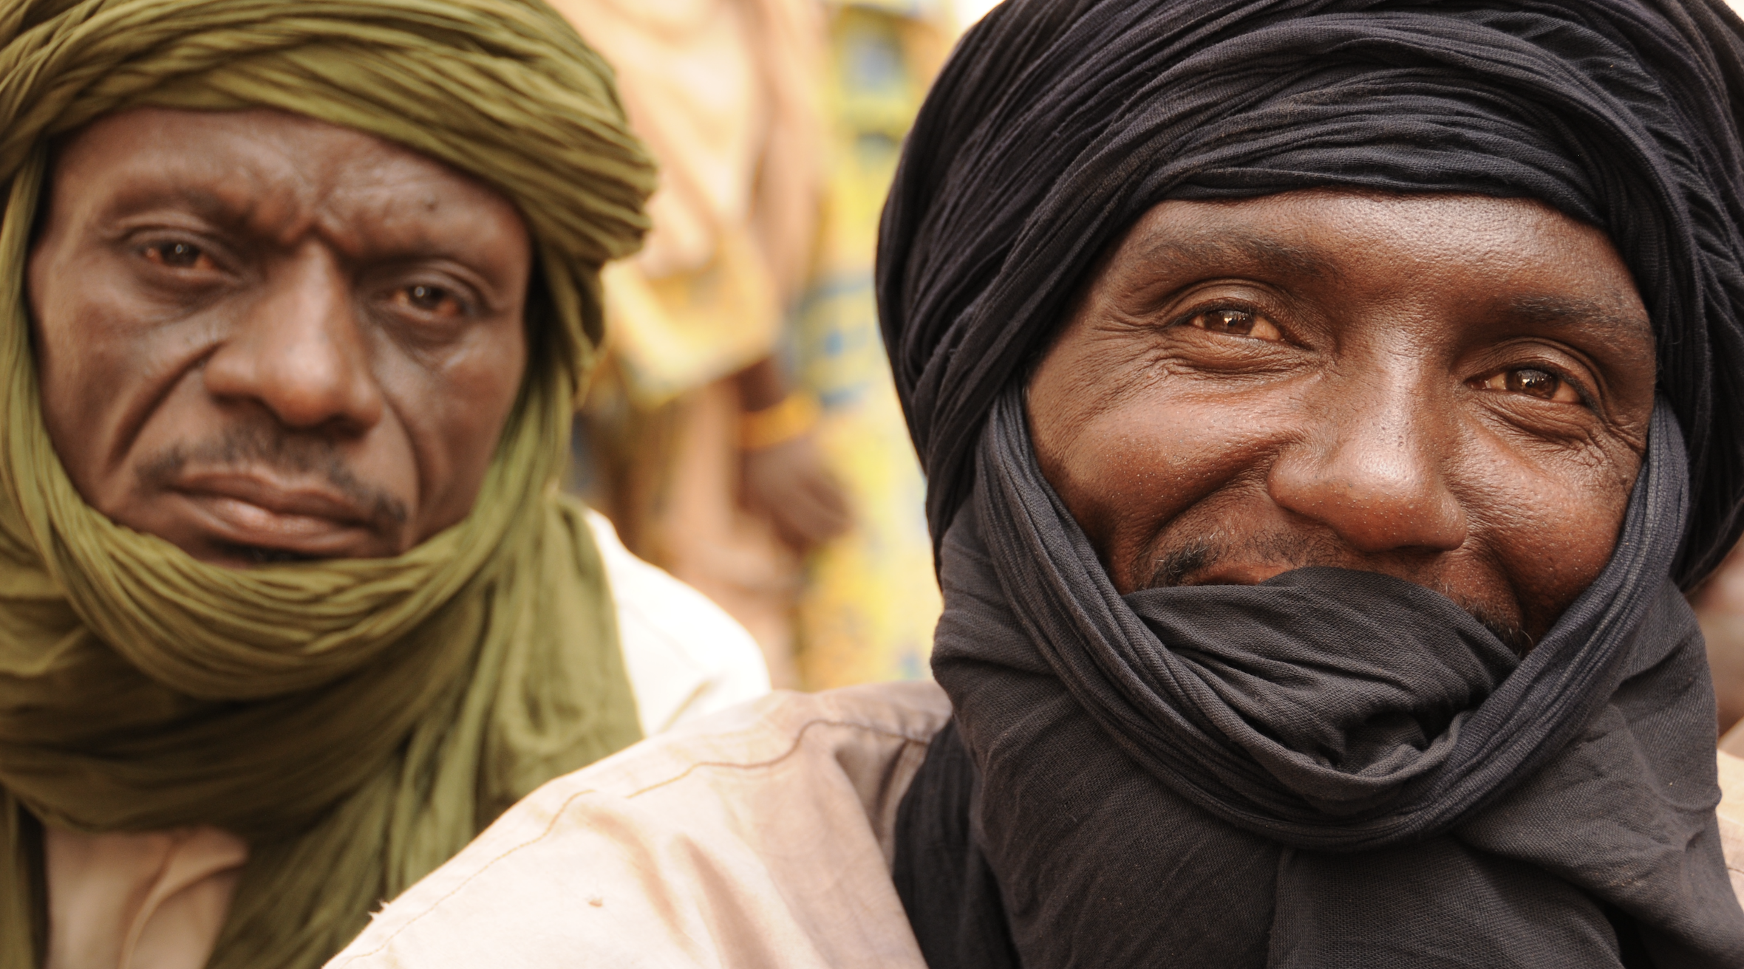
EVALUATION AND CLOSING
Photo by: Kevin McNulty

Slide 34
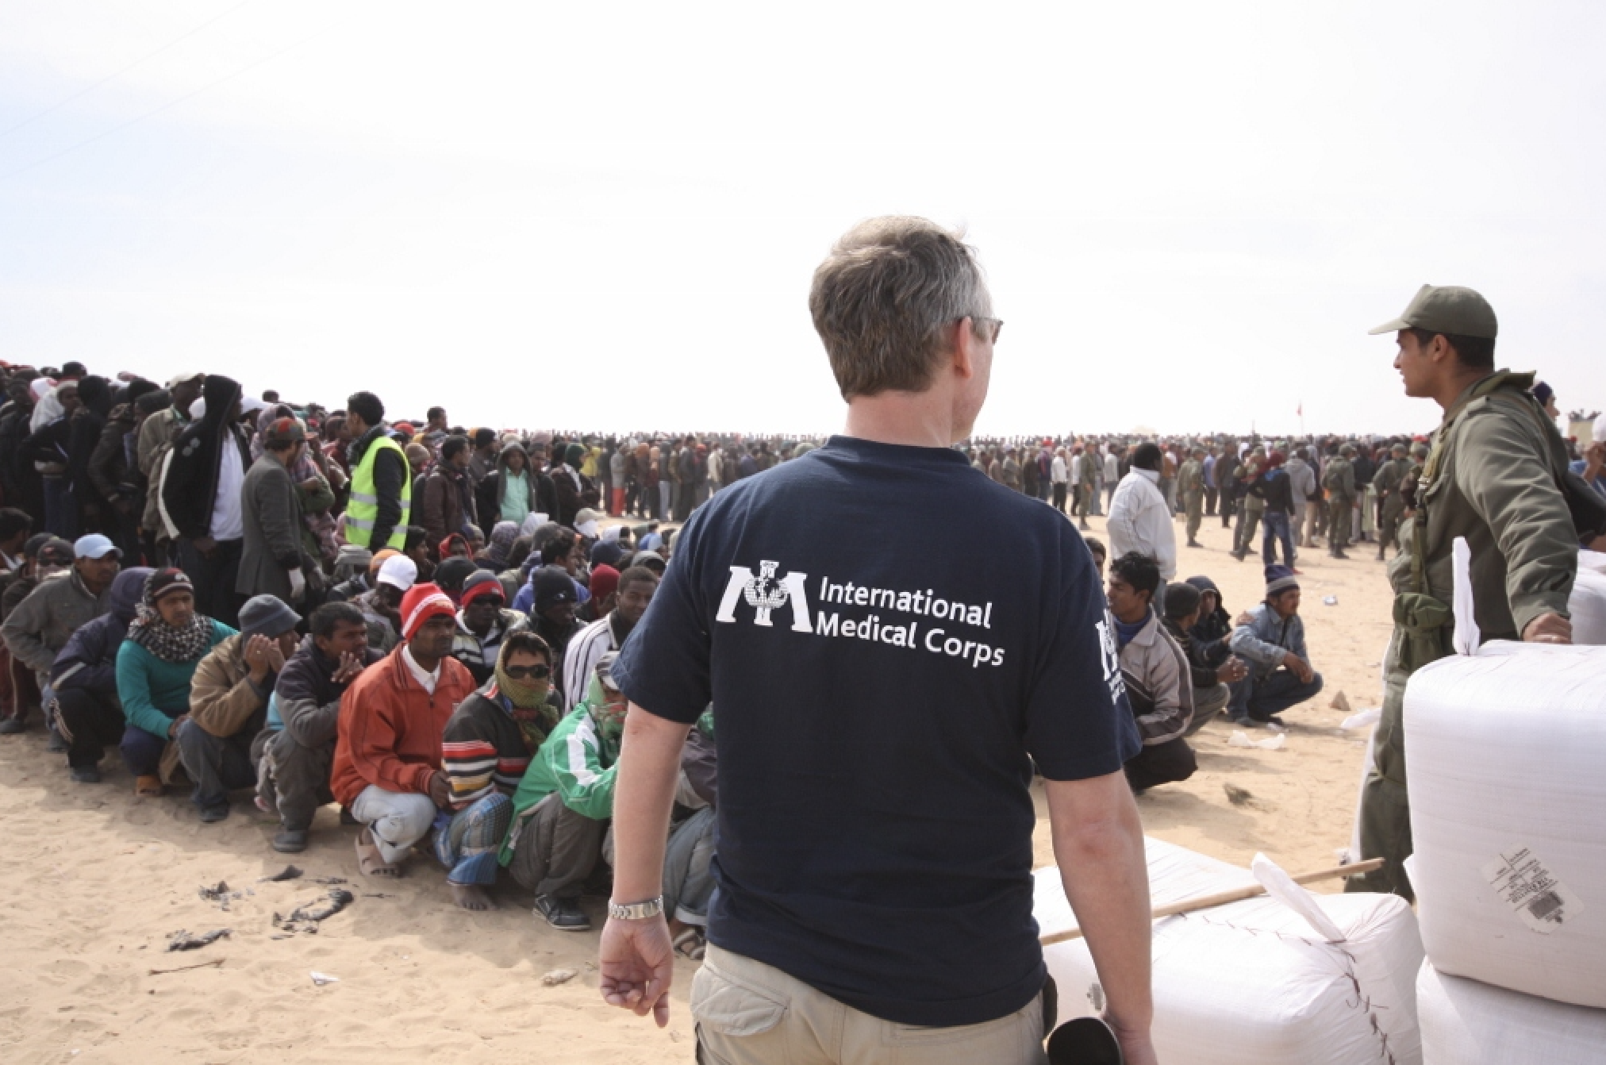
SURVEY
Let us know your thoughts.
Photo by: David Holmes
Link to evaluation: https://forms.gle/8WnGnoVHV856bj5d8
Notes:
NEED ACTUAL QR CODE WITHOUT CROPPING

Slide 35


THANK YOU
for your participation
The Optimising Armed Actor Engagement for Protection Outcomes training module is made possible by the generous support of the American people through USAID's Bureau of Humanitarian Assistance (BHA). The content of this training module is the responsibility of InterAction and does not necessarily reflect the views of USAID or the United States government.

Slide 36
ADDITIONAL SLIDE IF NEEDED

Slide 37
ADDITIONAL SLIDE IF NEEDED

Slide 38
ADDITIONAL SLIDE IF NEEDED

